Slide 1










Slide 2
HTML
Hyper Text Markup Language
HTML (HyperText Markup Language) is the most basic building block of the Web.
It defines the meaning and structure of web content.

Slide 3

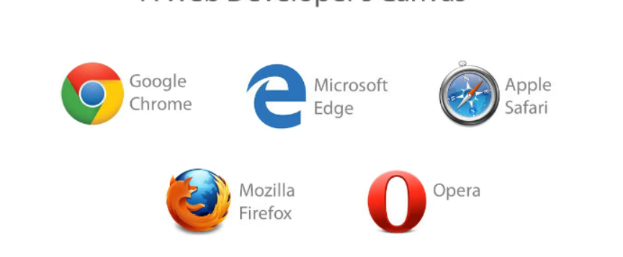

Slide 4
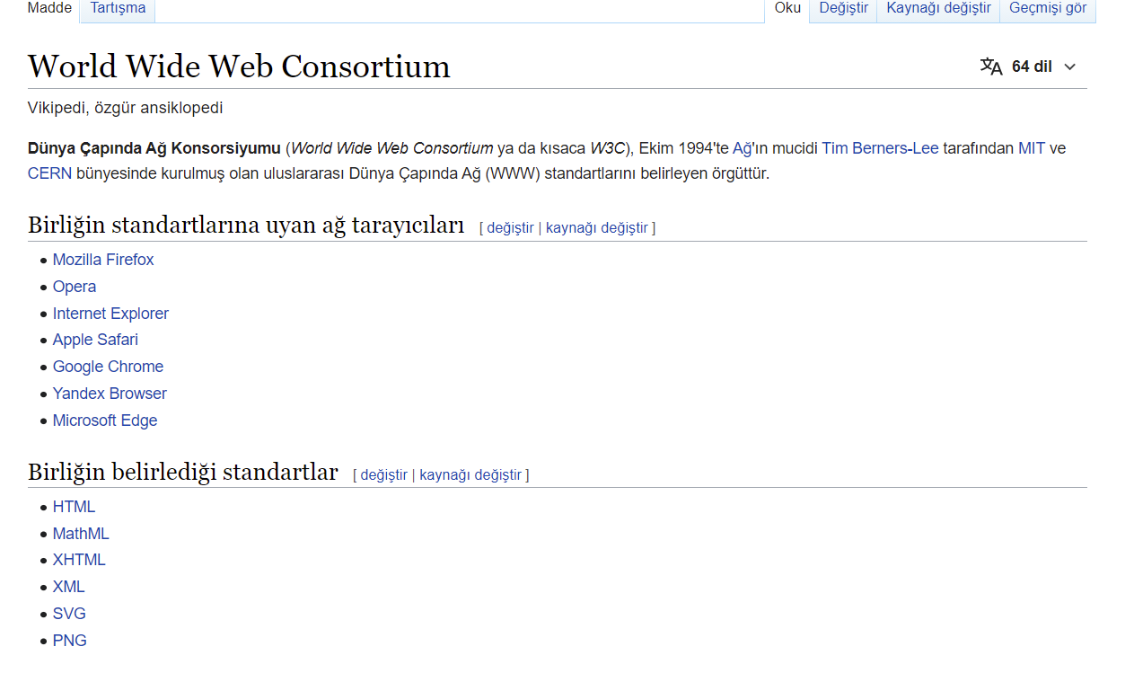


Slide 5
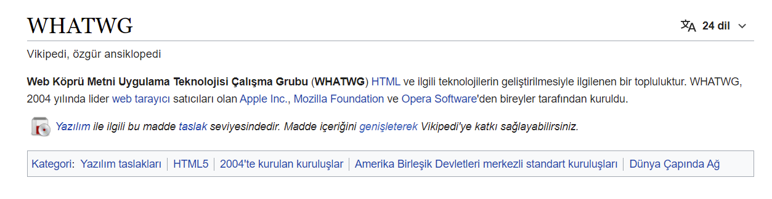

Slide 6
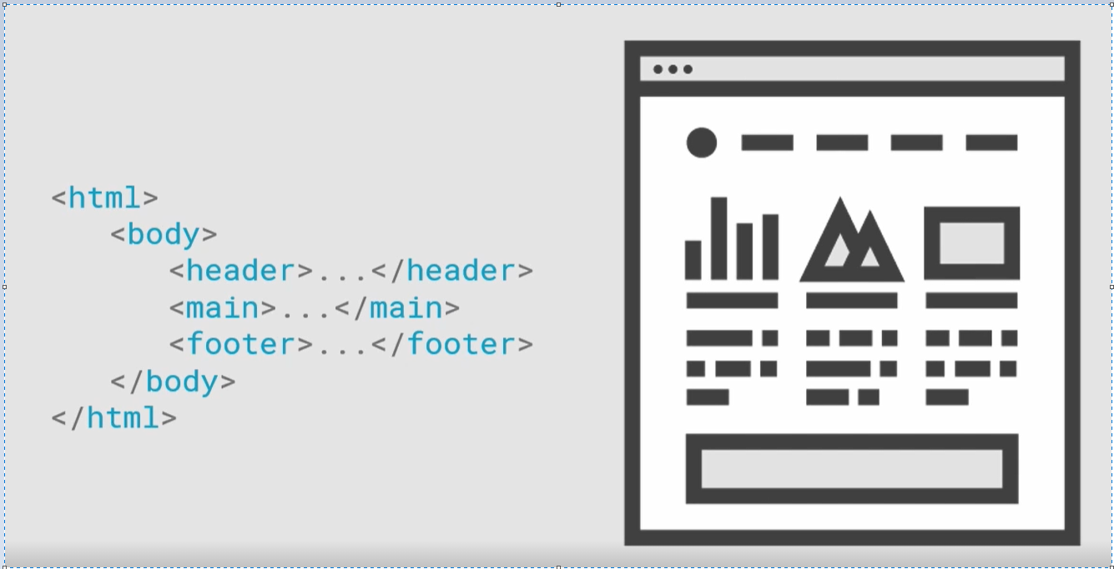

Slide 7


Slide 8
https://platform.html5.org/

Slide 9


Slide 10
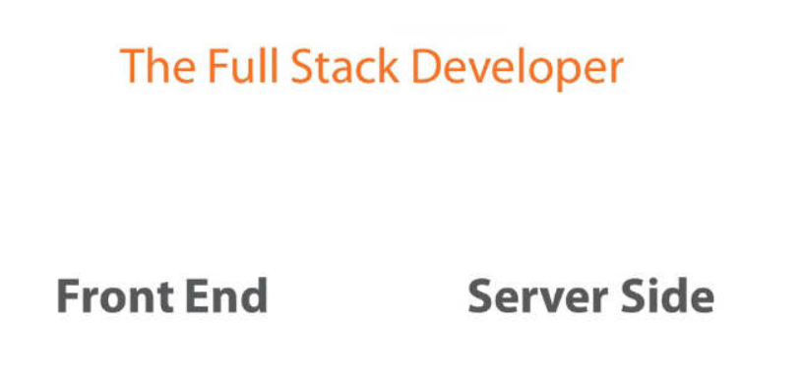

Slide 11


Slide 12





Slide 13
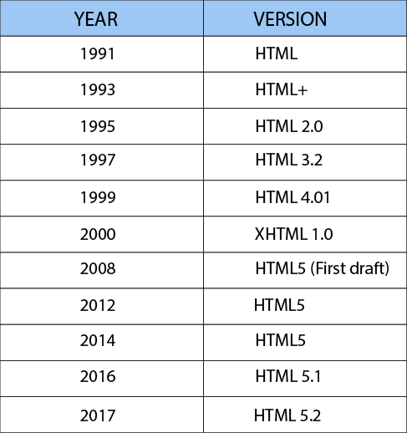


Slide 14





Editor

Slide 15
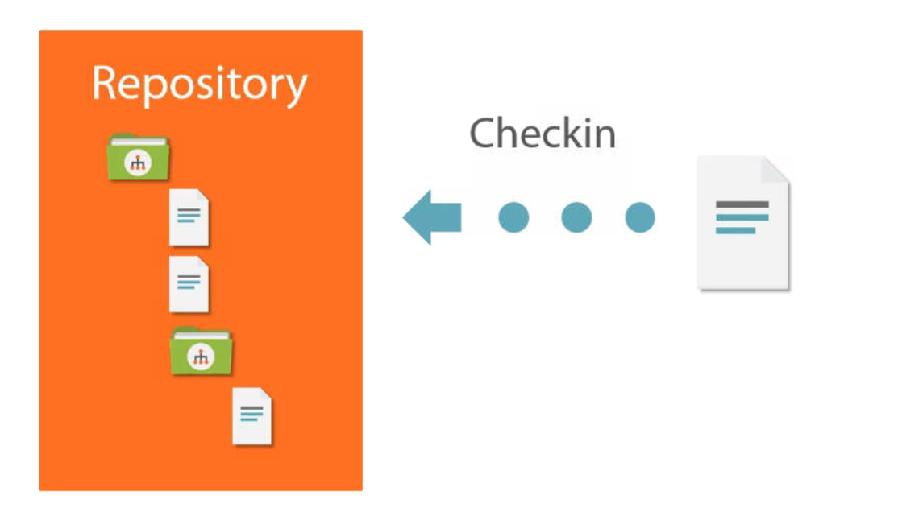

Slide 16
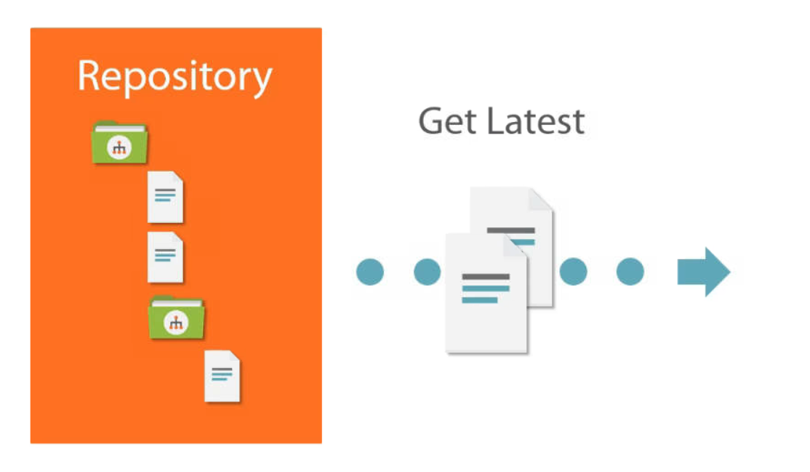

Slide 17


Slide 18


Slide 19
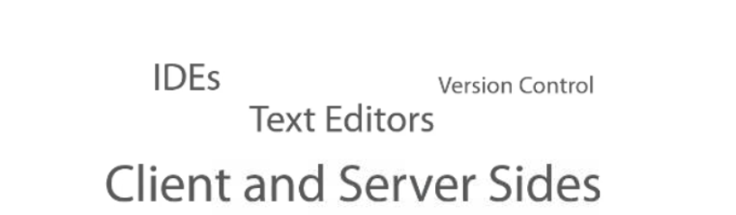

Slide 20
KURULUM
Visual studio code

Slide 21


https://developer.mozilla.org/en-US/docs/Web/HTML/Element
https://www.w3schools.com/html/html_elements.asp

Slide 22
UYGULAMALI ÇALIŞMA
Genel elementleri tanıyalım

Slide 23


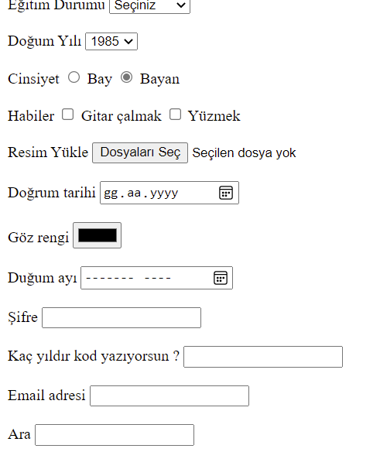
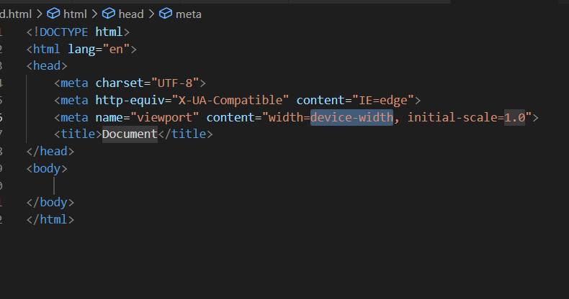
KAZANIMLAR
IDE kurulumunu yaptım
Live server eklentisinin kurulumunu yaptım
Html dökümanının genel yapısını biliyorum
Genel form elementleri ile denemeler
yapabiliyorum

Slide 24
<meta name="keywords" content="your, tags"/>
<meta name="description" content="150 words"/>
<meta name="subject" content="your website's subject">
<meta name="copyright"content="company name">
<meta name="language" content="ES">
<meta name="robots" content="index,follow" />
<meta name="revised" content="Sunday, July 18th, 2010, 5:15 pm" />
<meta name="abstract" content="">
<meta name="topic" content="">
<meta name="summary" content="">
<meta name="Classification" content="Business">
<meta name="author" content="name, email@hotmail.com">
<meta name="designer" content="">
<meta name="copyright" content="">
<meta name="reply-to" content="email@hotmail.com">
<meta name="owner" content="">
<meta name="url" content="http://www.websiteaddrress.com">
<meta name="identifier-URL" content="http://www.websiteaddress.com">
<meta name="directory" content="submission">
<meta name="category" content="">
<meta name="coverage" content="Worldwide">
<meta name="distribution" content="Global">
<meta name="rating" content="General">
<meta name="revisit-after" content="7 days">
<meta http-equiv="Expires" content="0">
<meta http-equiv="Pragma" content="no-cache">
<meta http-equiv="Cache-Control" content="no-cache">

Slide 25



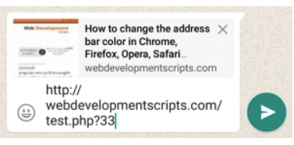
https://developer.twitter.com/en/docs/twitter-for-websites/cards/guides/getting-started
https://developers.facebook.com/docs/sharing/webmasters
<html>
<head>
<meta property="og:title" content="How to change the address bar color in Chrome, Firefox, Opera, Safari" />
<meta property="og:description" content="How to change the address bar color in Chrome, Firefox, Opera, Safari" />
<meta property="og:url" content="http://webdevelopmentscripts.com/64-how-to-change-the-address-bar-color-in-chrome-firefox-opera-safari" />
<meta property="og:image" content="http://webdevelopmentscripts.com/post-images/685b-change-browser-address-bar-color-chrome-android.jpeg" />
</head>
</html>

Slide 26
<meta http-equiv="cache-control" content="max-age=0" />
<meta http-equiv="cache-control" content="no-cache" />
<meta http-equiv="expires" content="0" />
<meta http-equiv="expires" content="Tue, 01 Jan 1980 1:00:00 GMT" />
<meta http-equiv="pragma" content="no-cache" />

Slide 27
<meta charset="utf-8">

Slide 28
<meta name="viewport" content="width=device-width, initial-scale=1.0, maximum-scale=1.0, user-scalable=no">

Slide 29
<meta http-equiv="X-UA-Compatible" content="IE=9; IE=8; IE=7" />
https://docs.microsoft.com/en-us/openspecs/ie_standards/ms-iedoco/380e2488-f5eb-4457-a07a-0cb1b6e4b4b5

Slide 30
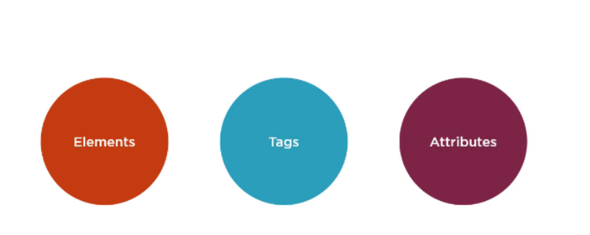

Slide 31
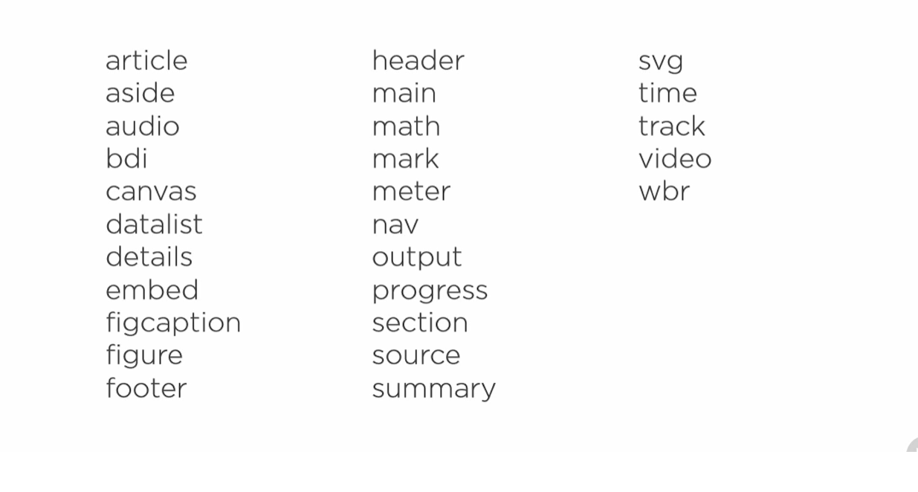
New Elements

Slide 32
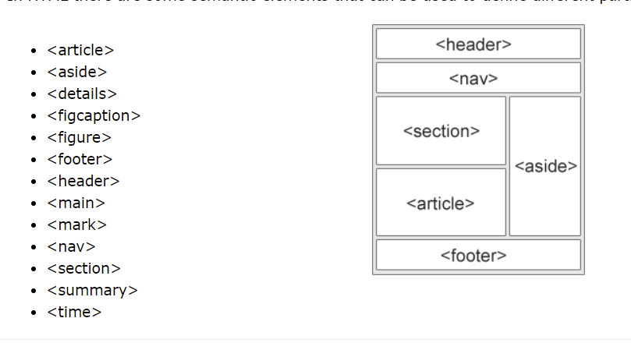
Semantic Elements

Slide 33
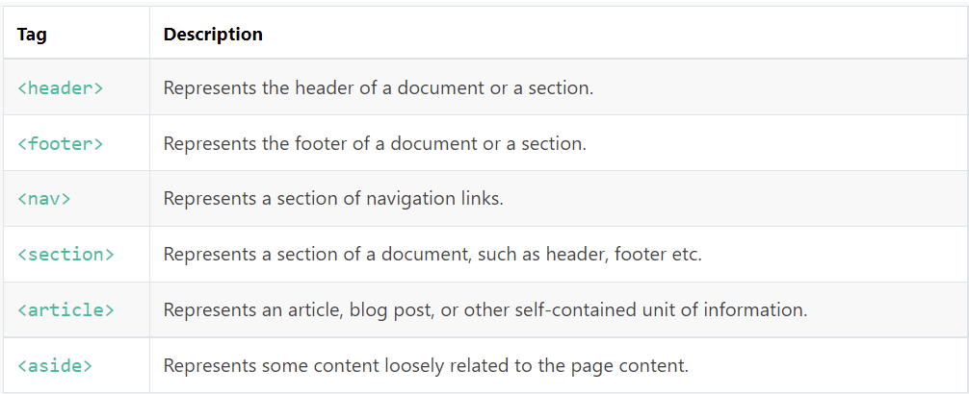

Slide 34
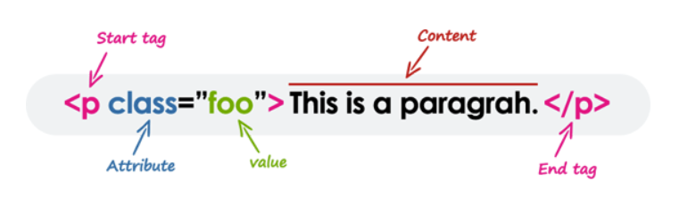

Slide 35
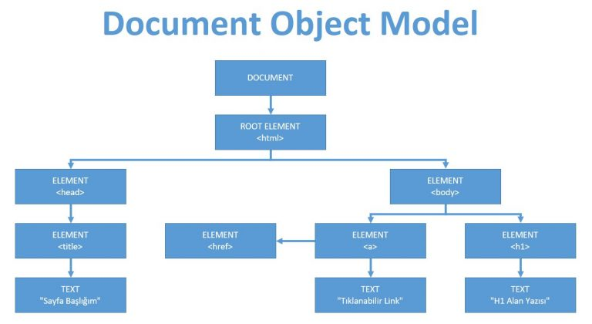

Slide 36
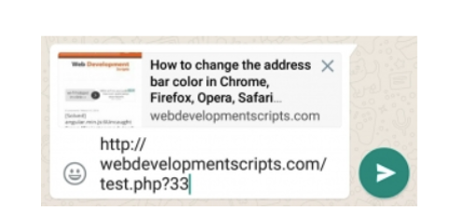
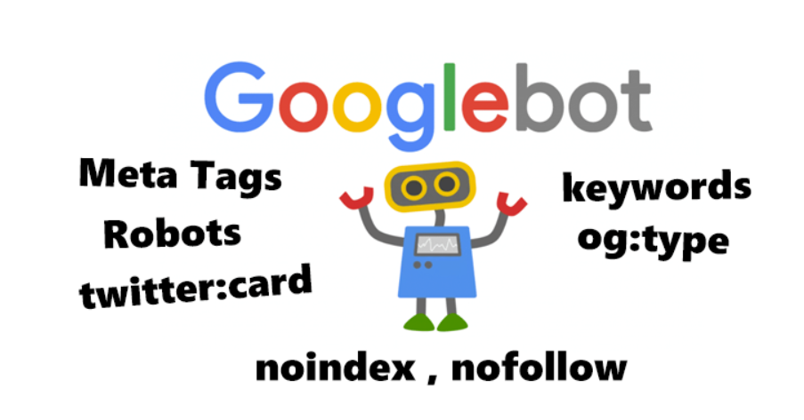
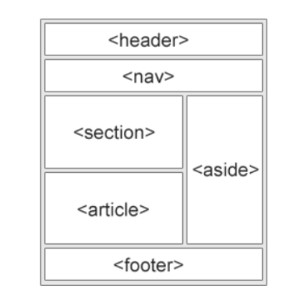

<html>
<head>
<meta property="og:title" content="How to change the address bar color in Chrome, Firefox, Opera, Safari" />
<meta property="og:description" content="How to change the address bar color in Chrome, Firefox, Opera, Safari" />
<meta property="og:url" content="http://webdevelopmentscripts.com/64-how-to-change-the-address-bar-color-in-chrome-firefox-opera-safari" />
<meta property="og:image" content="http://webdevelopmentscripts.com/post-images/685b-change-browser-address-bar-color-chrome-android.jpeg" />
</head>
</html>
***Cache
Semantic Elements
<meta charset="utf-8">
<meta name="viewport" content="width=device-width, initial-scale=1.0, maximum-scale=1.0, user-scalable=no">

Slide 37
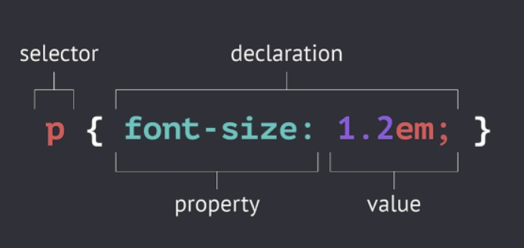

Slide 38
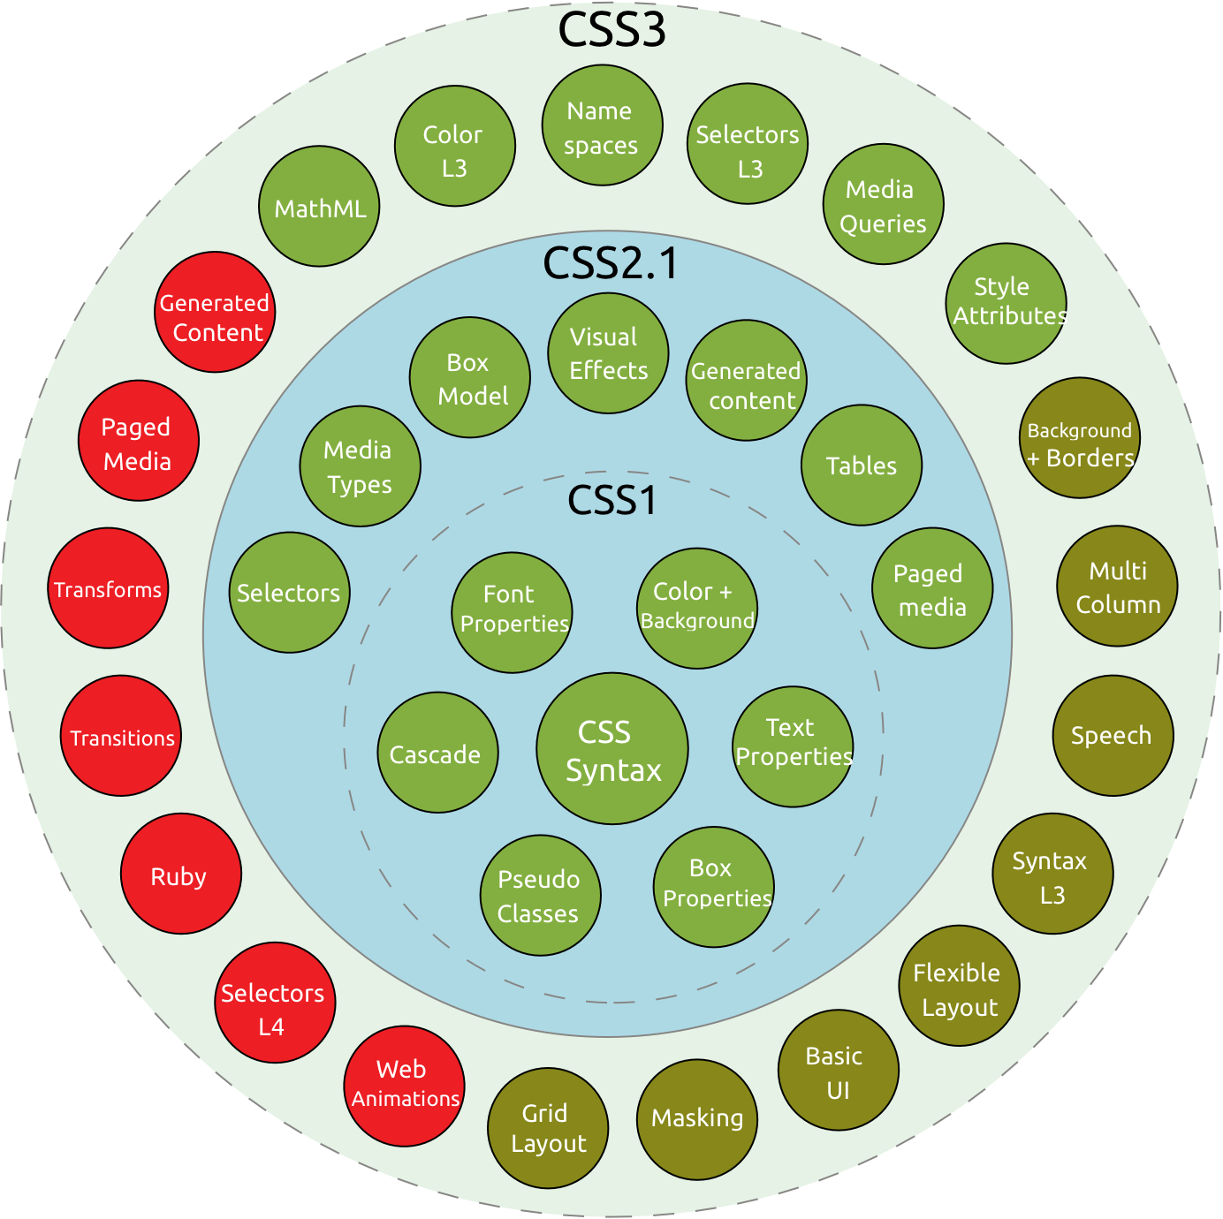

Slide 39
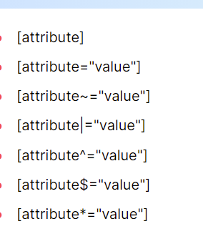
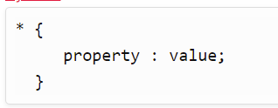
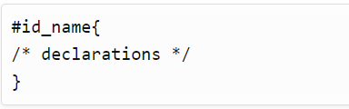
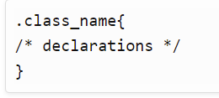
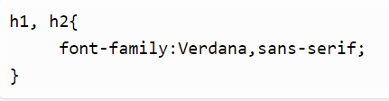
CSS Attiribute Selector,
CSS Universal Selector,
.
CSS Id Selector,
CSS Class Selector,
CSS Element Selector
CSS Group Selector

Slide 40
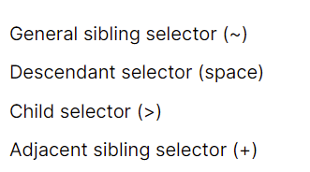
Div~p → div ile aynı dalde sonraki aynı anneye bağlı p ler
Div p → Div içinde bulunan tüm p ler
Div>p→Div içinde bulunan ilk daldaki p ler
Div+p →Div le aynı dalda hemen sonraki p

Slide 41
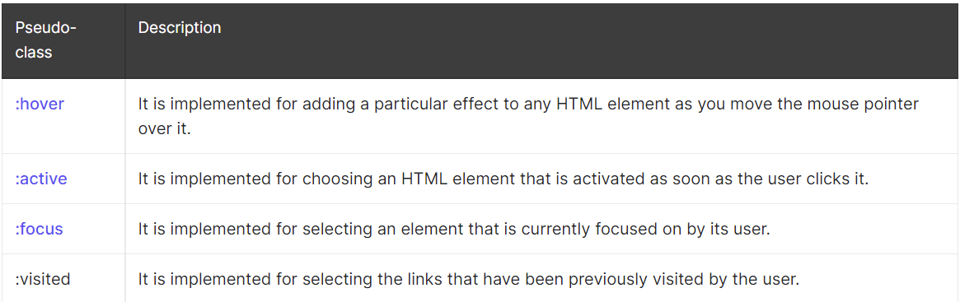

Slide 42
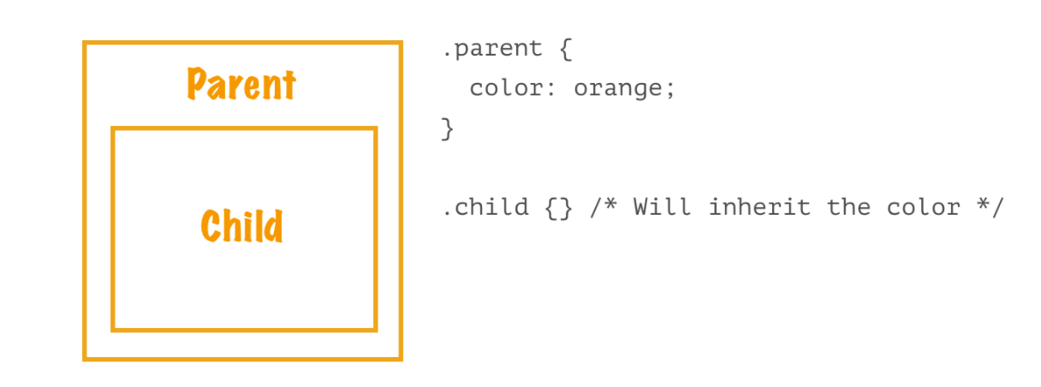

Slide 43
INHERITANCE
border-collapse
border-spacing
caption-side
color
cursor
direction
empty-cells
font-family
font-size
font-style
font-variant
font-weight
font-size-adjust
font-stretch

Slide 44
font
letter-spacing
line-height
list-style-image
list-style-position
list-style-type
list-style
orphans
quotes
tab-size
text-align
text-align-last
text-decoration-color
text-indent
text-justify
text-shadow
text-transform
visibility
white-space
widows
word-break
word-spacing
INHERITANCE

Slide 45
initial | Tarayıcıların atadığı başlangıç değerini ifade eder
inherit | Anneden aktar.
unset | Eğer kalıtsal bir değer alıyorsa kalıtsal değerine döndürür, kalıtsal değeri yoksa başlangıç değerine döndüren bir kısayoldur
revert | Geliştiricinin atadığı değerleri sıfırlar
revert ve unset önceki atamaları siler ancak kalıtsallık aktiftir
unset ile revert değerlerinin farkı: unset hem browser’ın hem de geliştiricinin atadığı değeri sıfırlarken, revert ise sadece geliştiricinin atamalarını sıfırlar.

Slide 46
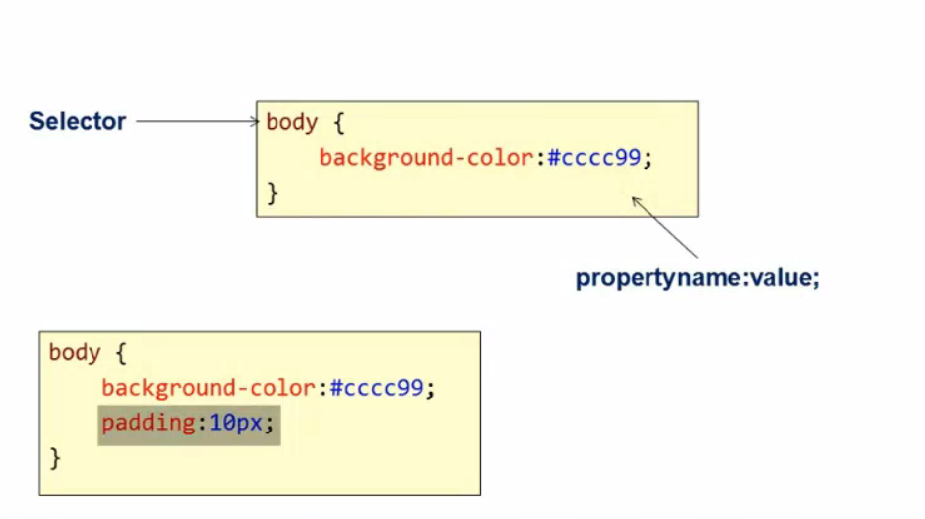

Slide 47
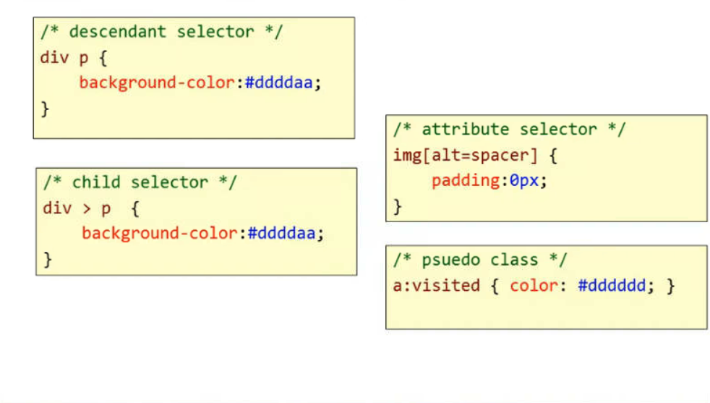

Slide 48
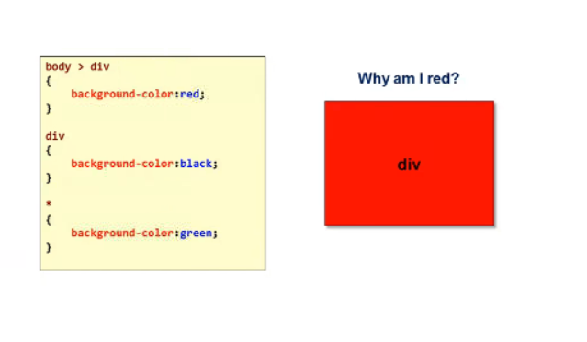

Slide 49
